Slide 1
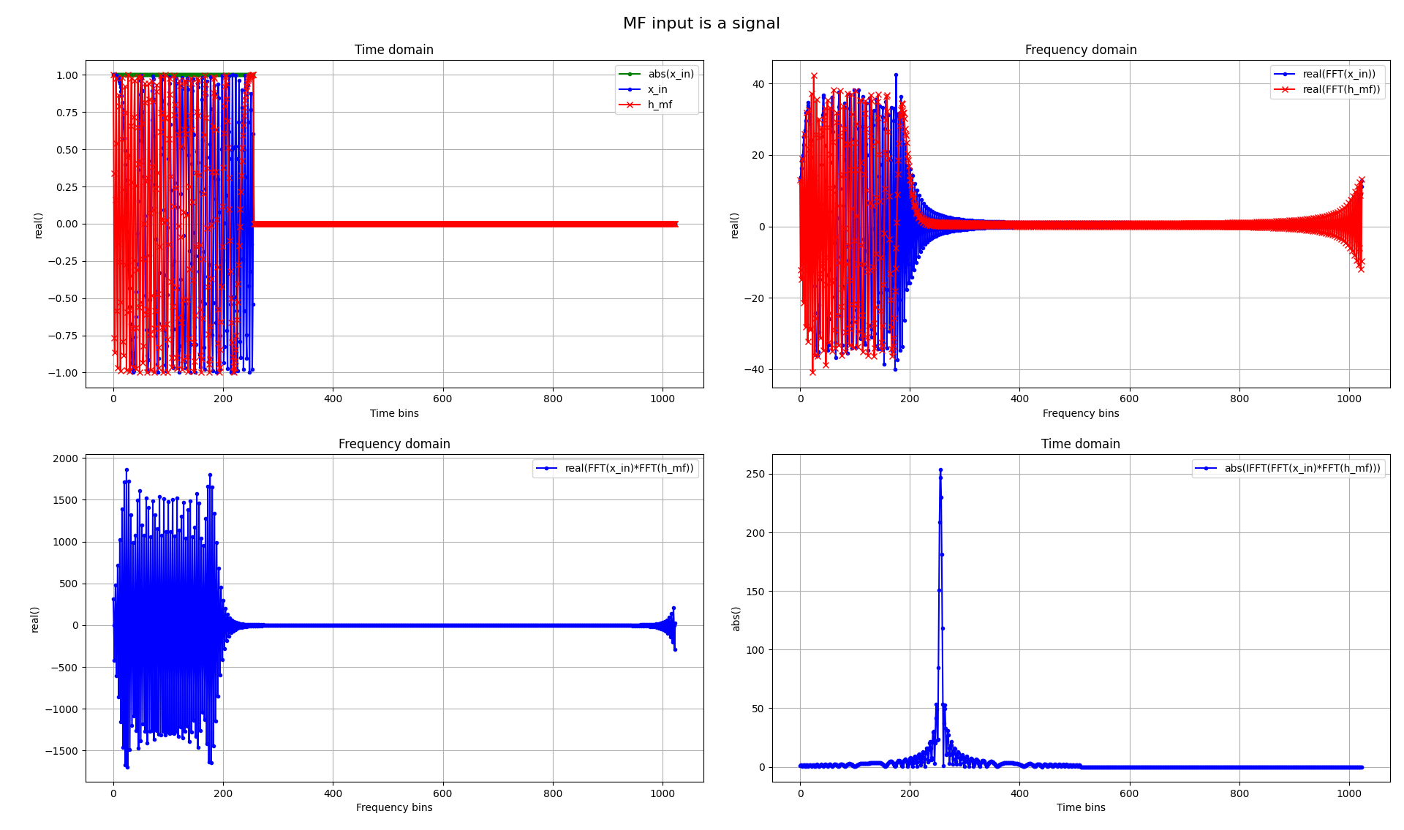
The Advanced Engineering Course
Primary Radar Signal Processing
Matched Filter derivation with modelling in Python
Aleksei Rostov, PhD,
Senior R&D Engineer,
FPGA/Embedded Linux Developer,
aleksei.rostov@protonmail.com

Slide 2
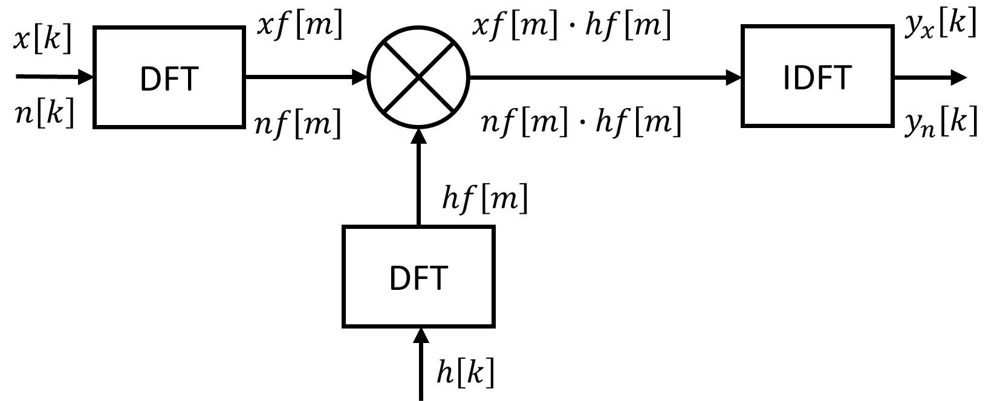
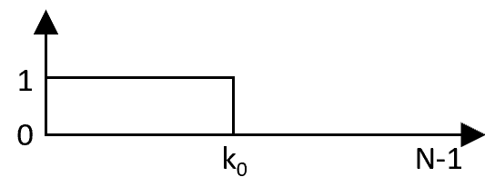
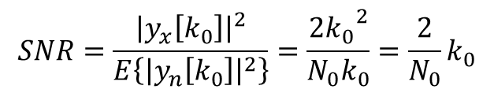
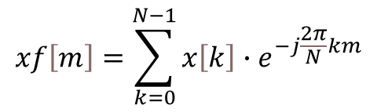
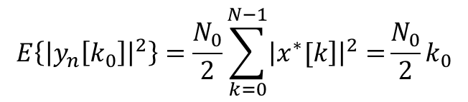

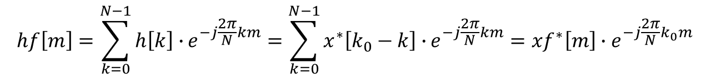
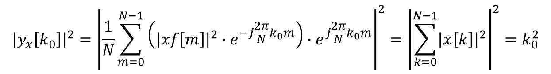

$$x\left[k\right]−input complex pulse signal with unity power, k=0…N−1$$
$$n\left[k\right]−input complex white noise with unity power$$
$$h\left[k\right]−complex impulse response$$
$$h\left[k\right]=x^{∗}\left[k_{0}−k\right]$$
$$hf\left[m\right]=\sum_{k=0}^{N−1}{h\left[k\right]∙}e^{−j\frac{2π}{N}km}=\sum_{k=0}^{N−1}{x^{∗}\left[k_{0}−k\right]∙}e^{−j\frac{2π}{N}km}={xf}^{∗}\left[m\right]{∙e}^{−j\frac{2π}{N}k_{0}m}$$
Matched Filtering in frequency domain
$$y_{n}\left[k_{0}\right]=\frac{1}{N}\sum_{m=0}^{N−1}{\left(nf\left[m\right]{∙xf}^{∗}\left[m\right]{∙e}^{−j\frac{2π}{N}k_{0}m}\right){∙e}^{j\frac{2π}{N}k_{0}m}=\frac{1}{N}\sum_{m=0}^{N−1}{nf\left[m\right]{∙xf}^{∗}\left[m\right]}=\sum_{k=0}^{N−1}{\left.n[k]∙x^{∗}[k\right]} }$$
$$E\left\{{\left|y_{n}\left[k_{0}\right]\right|}^{2}\right\}=E\left\{\sum_{k_{1}=0}^{N−1}{n\left[k_{1}\right]}∙x^{∗}\left[k_{1}\right]∙\sum_{k_{2}=0}^{N−1}{n\left[k_{2}\right]}∙x^{∗}\left[k_{2}\right]\right\}=\sum_{k_{1}=0}^{N−1}{\sum_{k_{2}=0}^{N−1}{\left.E\{n[k_{1}]∙n[k_{2}\right]}}\}{∙x}^{∗}\left[k_{1}\right]{∙x}^{∗}\left[k_{2}\right]$$
$$E\left\{{\left|y_{n}\left[k_{0}\right]\right|}^{2}\right\}=\frac{N_{0}}{2}\sum_{k=0}^{N−1}{{\left|\left.x^{∗}[k\right]\right|}^{2}=}\frac{N_{0}}{2}k_{0}$$
$$xf\left[m\right]=\sum_{k=0}^{N−1}{x\left[k\right]∙e^{−j\frac{2π}{N}km}}$$
$$xf\left[m\right]∙hf\left[m\right]={xf\left[m\right]∙xf}^{∗}\left[m\right]{∙e}^{−j\frac{2π}{N}k_{0}m}{=\left|xf\left[m\right]\right|}^{2}{∙e}^{−j\frac{2π}{N}k_{0}m}$$
$$SNR=\frac{{\left|y_{x}\left[k_{0}\right]\right|}^{2}}{E\left\{{\left|y_{n}\left[k_{0}\right]\right|}^{2}\right\}}=\frac{2{k_{0}}^{2}}{{N_{0}k}_{0}}=\frac{2}{N_{0}}k_{0}$$
$${\left|y_{x}\left[k_{0}\right]\right|}^{2}={\left|\frac{1}{N}\sum_{m=0}^{N−1}{\left({\left|xf\left[m\right]\right|}^{2}∙e^{−j\frac{2π}{N}k_{0}m}\right)}{∙e}^{j\frac{2π}{N}k_{0}m}\right|}^{2}={\left|\sum_{k=0}^{N−1}{{\left|x\left[k\right]\right|}^{2}}\right|}^{2}=k_{0}^{2}$$
aleksei.rostov@protonmail.com

